Slide 1
The Starbucks data hunt
Predicting Starbucks Yelp scores to find the issues that matter

Slide 2
motivation
Executive, VIP Starbucks connoisseur who often clocks more hours at his local coffee bean hangout than even the baristas themselves
Just like how a neighbor longs to improve their neighborhood, a coffee addict naturally wants the best for his coffee kingdom (aka caffeine drug dealer)

Slide 3
Issues at Starbucks
Lingering homeless people who smell horribly and talk to themselves
Unclean bathrooms and overflowing garbage cans
The “barista from hell”
Inconsistent drink quality

Slide 4
Objective
Figure out which issues customers care more about using Yelp
Do this by making models to predict Starbucks Yelp star scores, and then examining predictors that contribute the most to these models

Slide 5
yelp
Yelp is a website that lets customers give public feedback to businesses.
Feedback consists of written reviews and “star” scores ranging from 1 - 5
5=coffee nirvana, 1 = like going to a coffee slave camp

Slide 6
Yelp Data
Yelp has freely provided some of its data as part of its “Yelp Dataset Challenge”
The data consists of json files, two of which I import and convert to pandas DataFrames in Python

Slide 7
Yelp data that I actually use
I make two tables – business and reviews
business contains a row for each store, which includes store id, review count, location, and star score
reviews contains a row for each review, which includes store id, date, review text content, and star score

Slide 8
Data wrangling
I make the following variables
Average year in which a store is reviewed
Dummy variables - clean vs unclean, homelessness problems yay/nay, unfriendly baristas yay/nay, a dummy for each state (all values =0 represents AZ)

Slide 9
Exploratory Data analysis
494 stores – 201 in AZ, 161 in NV
18 reviews per store on average
Data is provided for only 7 states, and Canada
Examine relationship between potential predictors and star score using statistical graphics

Slide 10
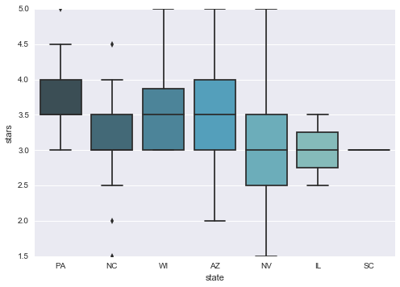
eda – stars by state

Slide 11
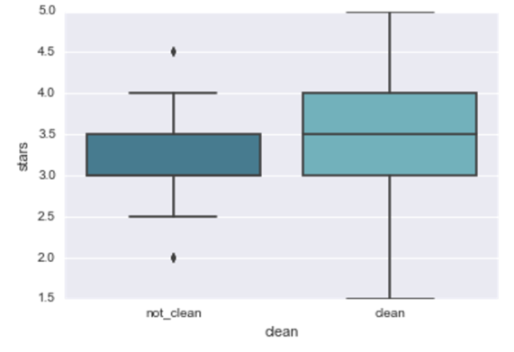
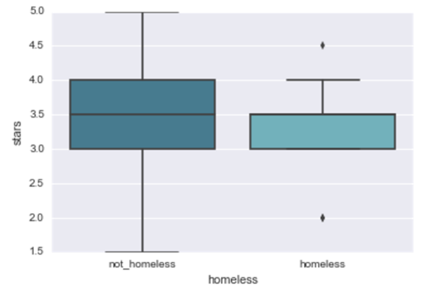
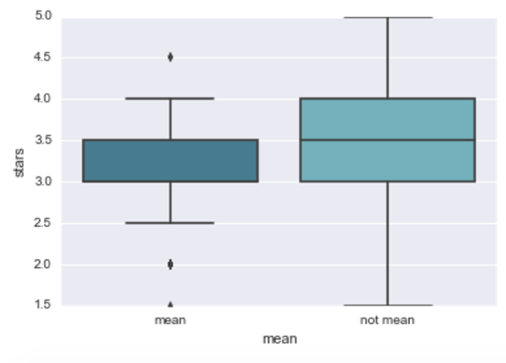
eda – stars by dummy variables

Slide 12
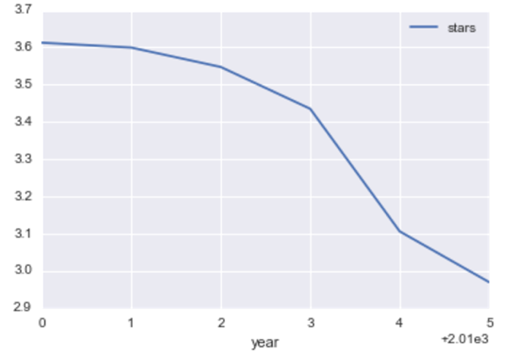
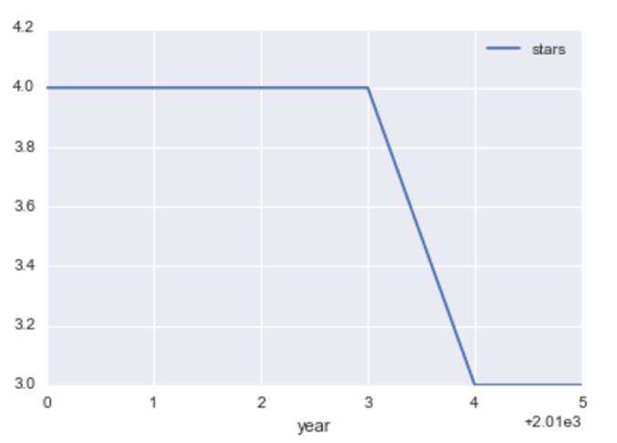
EDA – Avg and median stars by year
Avg Star Score by Year
Median Star Score by Year

Slide 13
predictors to use
mean review year, unclean, homeless, unfriendly, state dummy variables
review count, since it is correlated with unfriendly and unclean variables (.78, .54 correlation coefficients)

Slide 14
the models
Linear Regression (LR) , Principal Component Regression (PCR), Random Forests (RF), Gradient Boosted Trees (GBT)
Models will be compared and ranked by their root mean square error (rmse), the typical amount by which a model's predictions deviate from the actual values.

Slide 15
modeling specifics
LR and PCR built by splitting the data randomly into a 70% train split and 30% test split
RF and GBT built using 5-fold cross validation and grid search to tune certain model parameters

Slide 16
Linear regression
Significant coefficients at 5% level for :
unclean, unfriendly, mean review year, NC, NV, and QC
Unfriendly/Unclean stores see their predicted stars drop by .28 and .23, respectively
rmse .6544
Adj. R-Squared 13.7%,

Slide 17
Principal Component Regression
Select 10 principal components (PCs) - 79% of variance is retained, eigenvalues close to zero are excluded
Difficulty in interpreting resultant PCs and finding the most important variables
rmse decreases to .645 (from .654)
Adj. R-squared goes down to 10.8% (from 13.7%)

Slide 18
Random forests
Grid search tunes the size of the random subset of features (max_features) used at each split to be .10
Most important features are mean review year and review count, which does not seem interesting
rmse is .6495 (PCR<RF<LR)

Slide 19
Gradient boosted trees
Grid search optimizes: learning rate, tree depth, % of rows to sample while fitting model, max_features
Most important features are again mean review year and review count
rmse decreases to .622!

Slide 20
Results – important features
unclean, unfriendly, and state are important in LR
mean review year and review count are important in RF and GBT
In LR model, store cleanliness and barista friendliness are more important than homeless problems (though this model deserves further improvement)

Slide 21
Results – Predictability of models
RMSE
GBT .622
PCR .645
RF .649
LR .654
RMSE centered around the mean value

Slide 22
NEXT STEPS Further research and recommendations
Perform more sophisticated text analysis or sentiment analysis in making existing dummy variables
Include more variables using Yelp’s text review content
Include more variables from data outside Yelp’s data
Use internal Starbucks data

Slide 23
NEXT STEPS (Cont’d) Further research and recommendations
Make models for subgroups of Yelp data, like a model for each state
Make decisions from results of updated models. If drink quality is an issue, retrain baristas at stores with low star scores.
Use predicted star score as a predictor in models that predict a metric that is correlated with star score. This would be needed for new stores or stores with little Yelp data. Use internal data as a proxy for Yelp data.

Slide 24
Final remarks
Starbucks is a hub of community activity
By improving the customer experience, we improve our communities
Doing this also makes Starbucks more competitive and profitable. This is a win for everyone!

